Slide 1
PRE - MTAC
Processing and Maintenance Operations
July 14, 2022

Slide 2
Precision
Space
Processing
Year-Round
Strategy
Complement
Mike Barber
Vice President, Processing & Maintenance Operations
Vision
Strategy
Execution
Success

Slide 3
Peak Season Hot Wash Update
First - Thank you all for your communication and engagement
Planned and Delivered!
Peak Season 2021 was successful, thanks to planning & coordination, combined with industry collaboration
Review of Peak season 2021
Teams have completed Hot Wash activities and started Peak planning that will be shared in MTAC
Appreciative of Industry’s attendance and engagement during our Peak Industry calls
Utilization of the Industry Connect Dashboard for awareness of facility conditions
Lessons Learned
Earlier hiring and retention works
Secured facility space was instrumental to success
Installation of added automation – increase capacity and productivity
Continuation of efficiency gain processes

Slide 4
Peak 23 Readiness – Customer Focus
84 Annexes planned (58 PSAs/Long term in place plus 24 Short term)
37 new package sorters to be deployed
Focus on improved processing efficiency and operating plan precision
Requesting Early notification for additional Peak Volume Pickups
Facilities have been updated and validated in FAST

Slide 5
Industry Engagement
Thank you for your communication and engagement
Looking forward to continued engagement with Industry
Efforts through MTAC User Groups (UG) and Work Groups (WG)
Please continue to work through/notify your postal representatives immediately if you have any issues or concerns
This allows for capture of common issues, concerns, consolidated resolutions and if necessary, escalations
Looking forward to another successful year and peak season

Slide 6
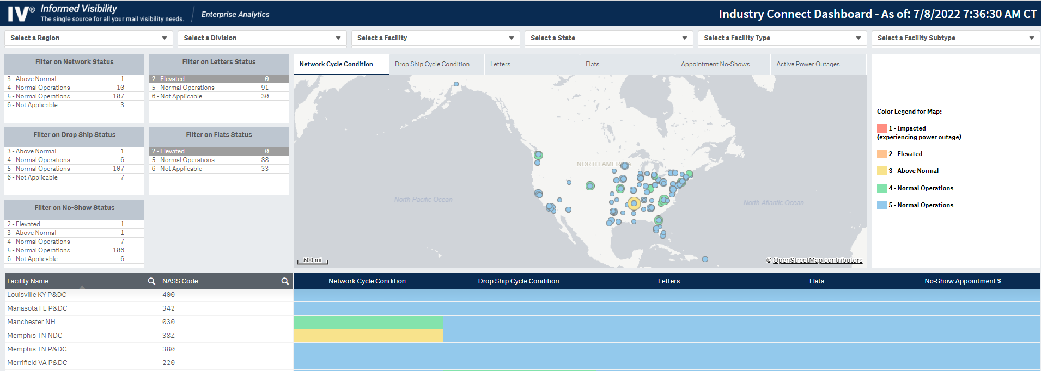
Industry Connect Dashboard

Slide 7
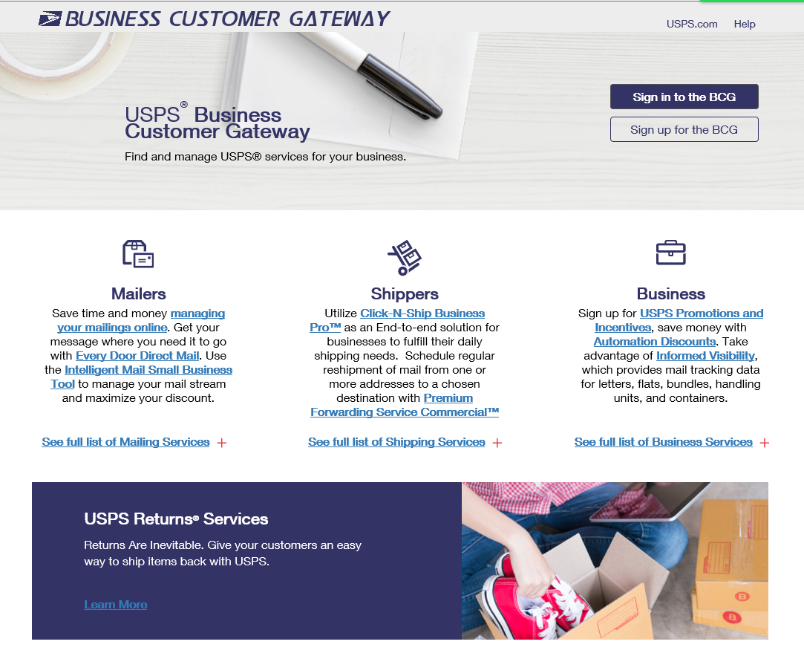
Gaining Access

Slide 8
Industry Connect – Overview (What it Provides)
Birds eye view of processing centers overall conditions
Dashboard provides current conditions for USPS processing facilities
Provides varied Status types
Network (Transportation)
Drop Shipment (Entry conditions)
Letters
Flats
No Shows (Appointment conditions)
Users can select specific geographic regions or processing center types
The information is refreshed hourly to provide the most current conditions
Additional content requests are to be administered via the related department and the Enterprise Analytics team

Slide 9
PRE - MTAC
Logistics
July 14, 2022

Slide 10
Robert Cintron
Vice President, Logistics

Slide 11
Internal Focus
MTE purchasing continues to build inventory
MTE inventory is growing
New purchases continue to arrive
MTE inventory
Bi-weekly plant inventory (July 2022)
MTE Quality Checks
Verification of proper prepared MTE returns
Generates good product and hygiene

Slide 12
UG 7 Update
Bi-Weekly Meetings
Industry contact information
Industry information has been updated in MTEOR
Large mailers completed – June 2022
Small mailers being updated – August 2022
Guide / Training for MTEOR process
Fall Mailing
Identify on hand inventory and demand by industry mailer
Industry is working to have all facilities report MTE MTEOR inventory
MTEOR Helpdesk information (MTEOR@usps.gov/1-866-330-3404)

Slide 13
Industry Focus
Predictive MTE forecasting
Identifies geographic demand for reallocating MTE
Utilize MTEOR for MTE Request
Provides consistency in reporting and moving geographically
All sites request through MTEOR
Weekly MTE inventory reporting
Generate MTE flow between USPS and Industry
Identifies industry usage
MTE quality checks
Industry identify hygiene or concerns
contact helpdesk

